Slide 1
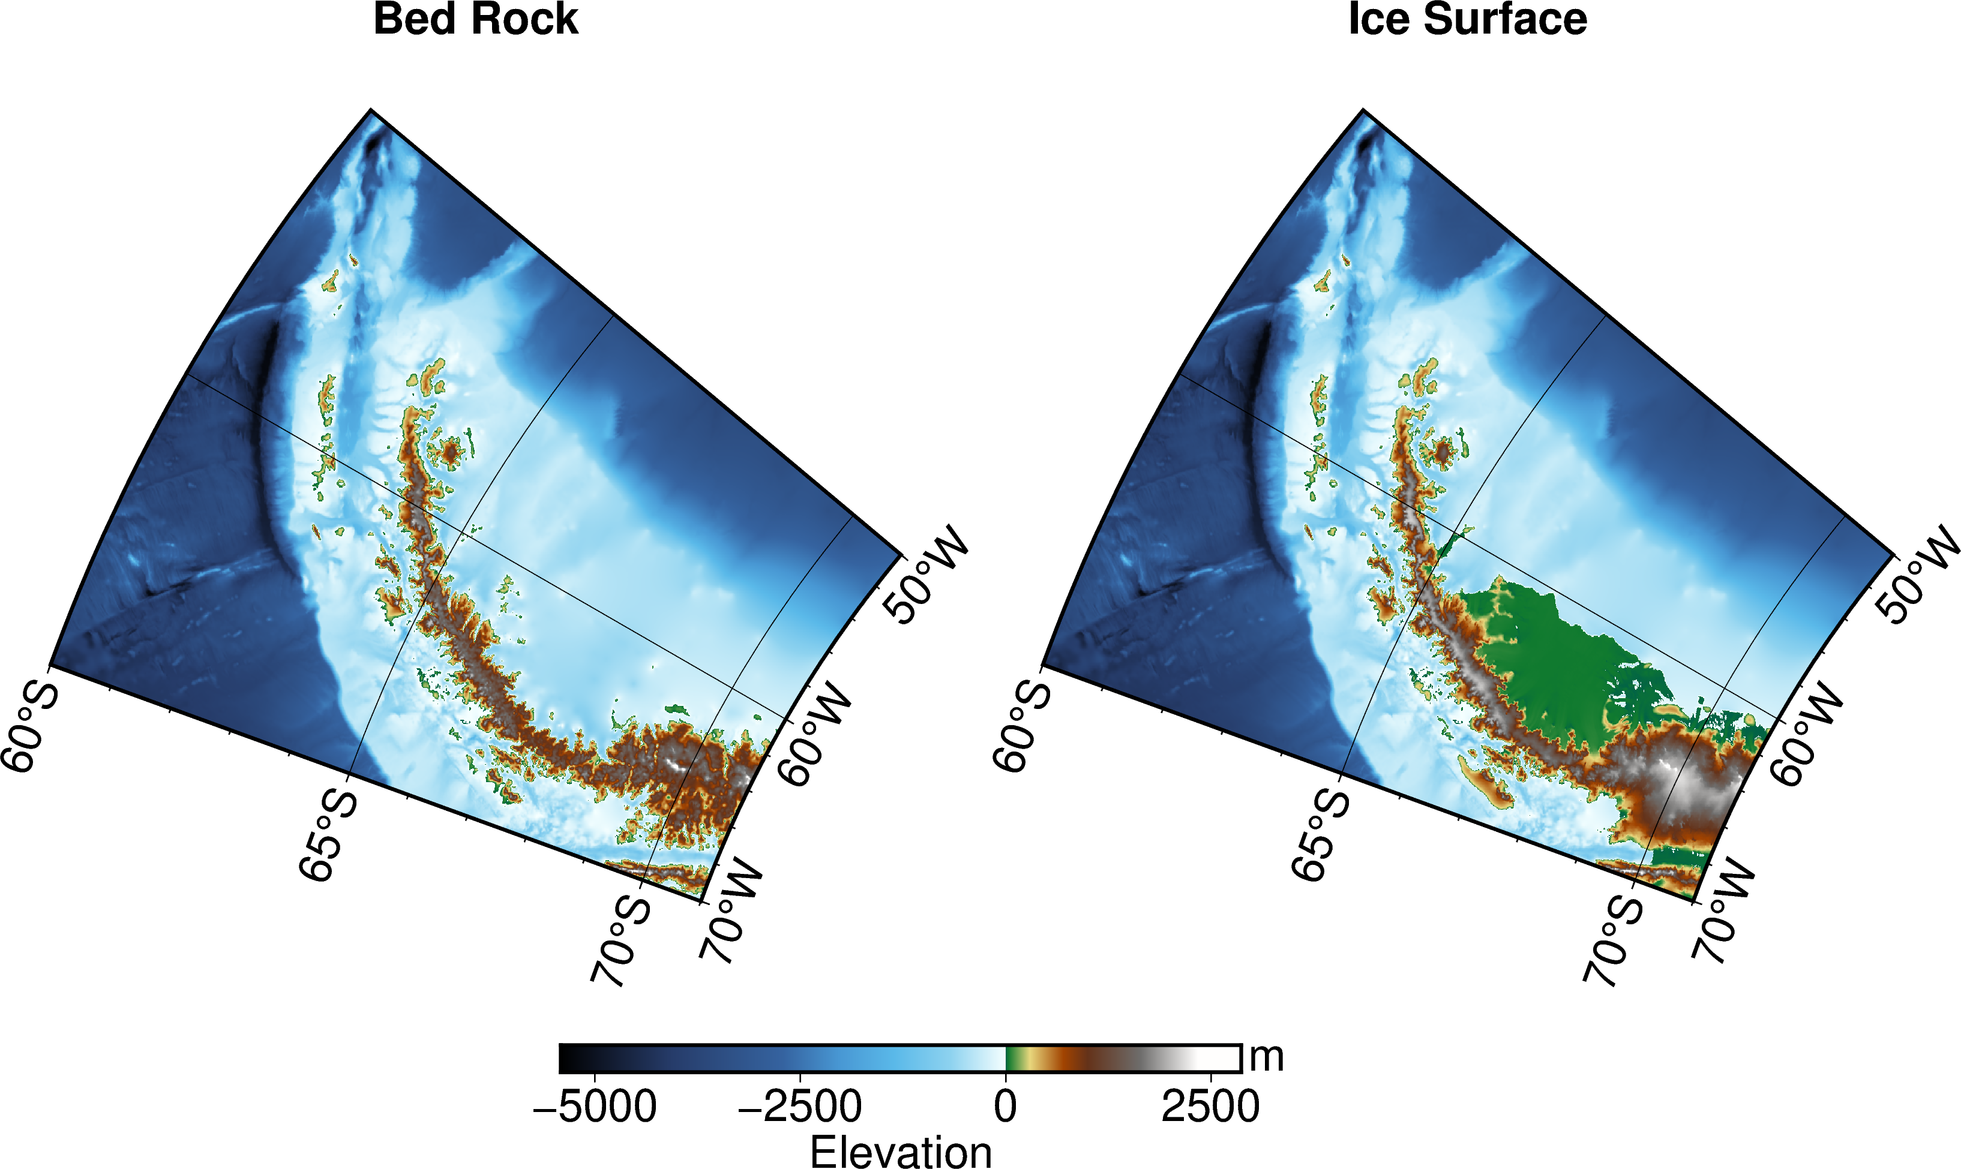
Antarctic Maps using the IBCSO version 2
Larsen Ice Shelf

Slide 2
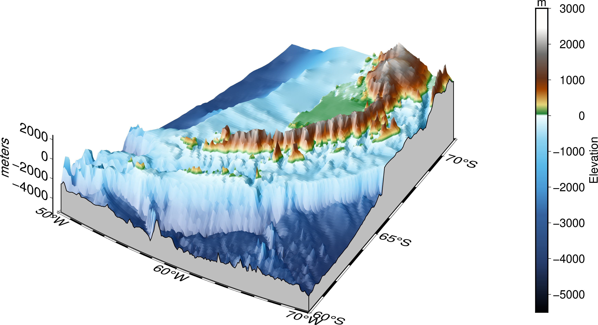
3D map of the Antarctic Peninsula (South Shetland Islands point of view)
Antarctic Peninsula
South Shetlands Is.
Weddell Sea
Elephant Is.
Drake Passage

Slide 3
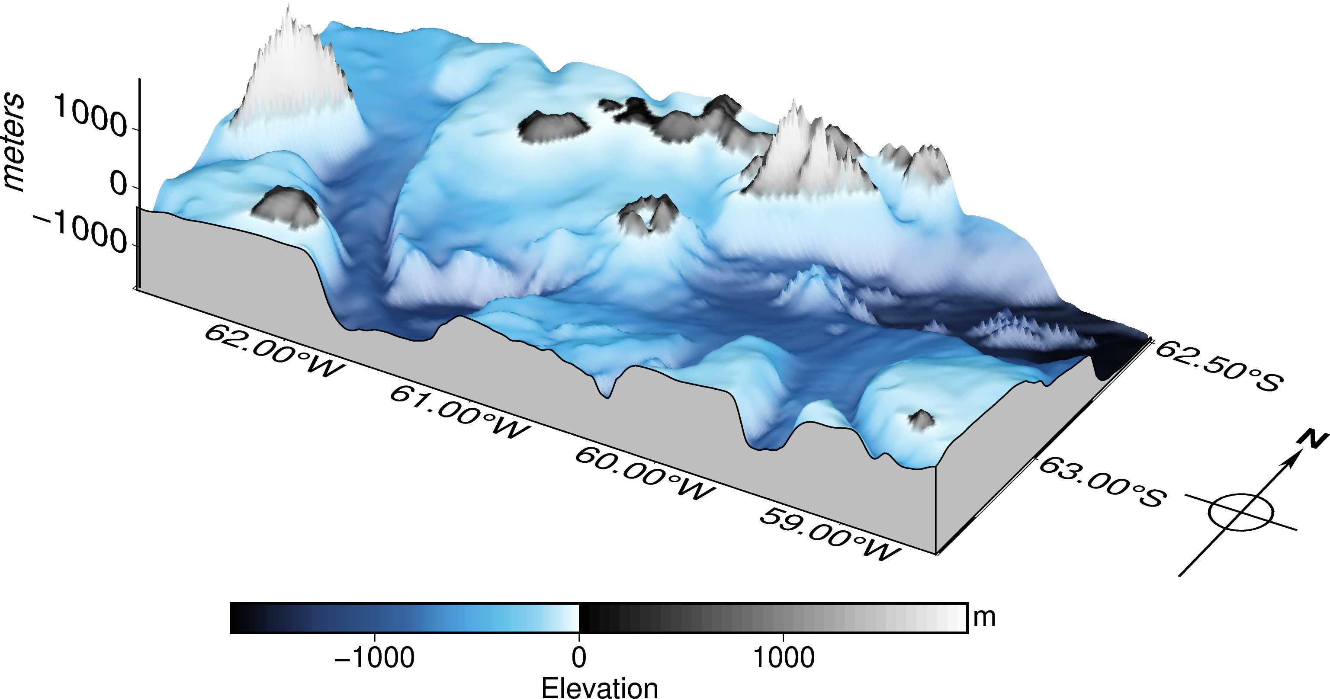
Deception Island
Smith Is.
Livingston Is.
The Axe
(geological feature)
Three Sisters
(geological feature)
Deception Is.

Slide 4
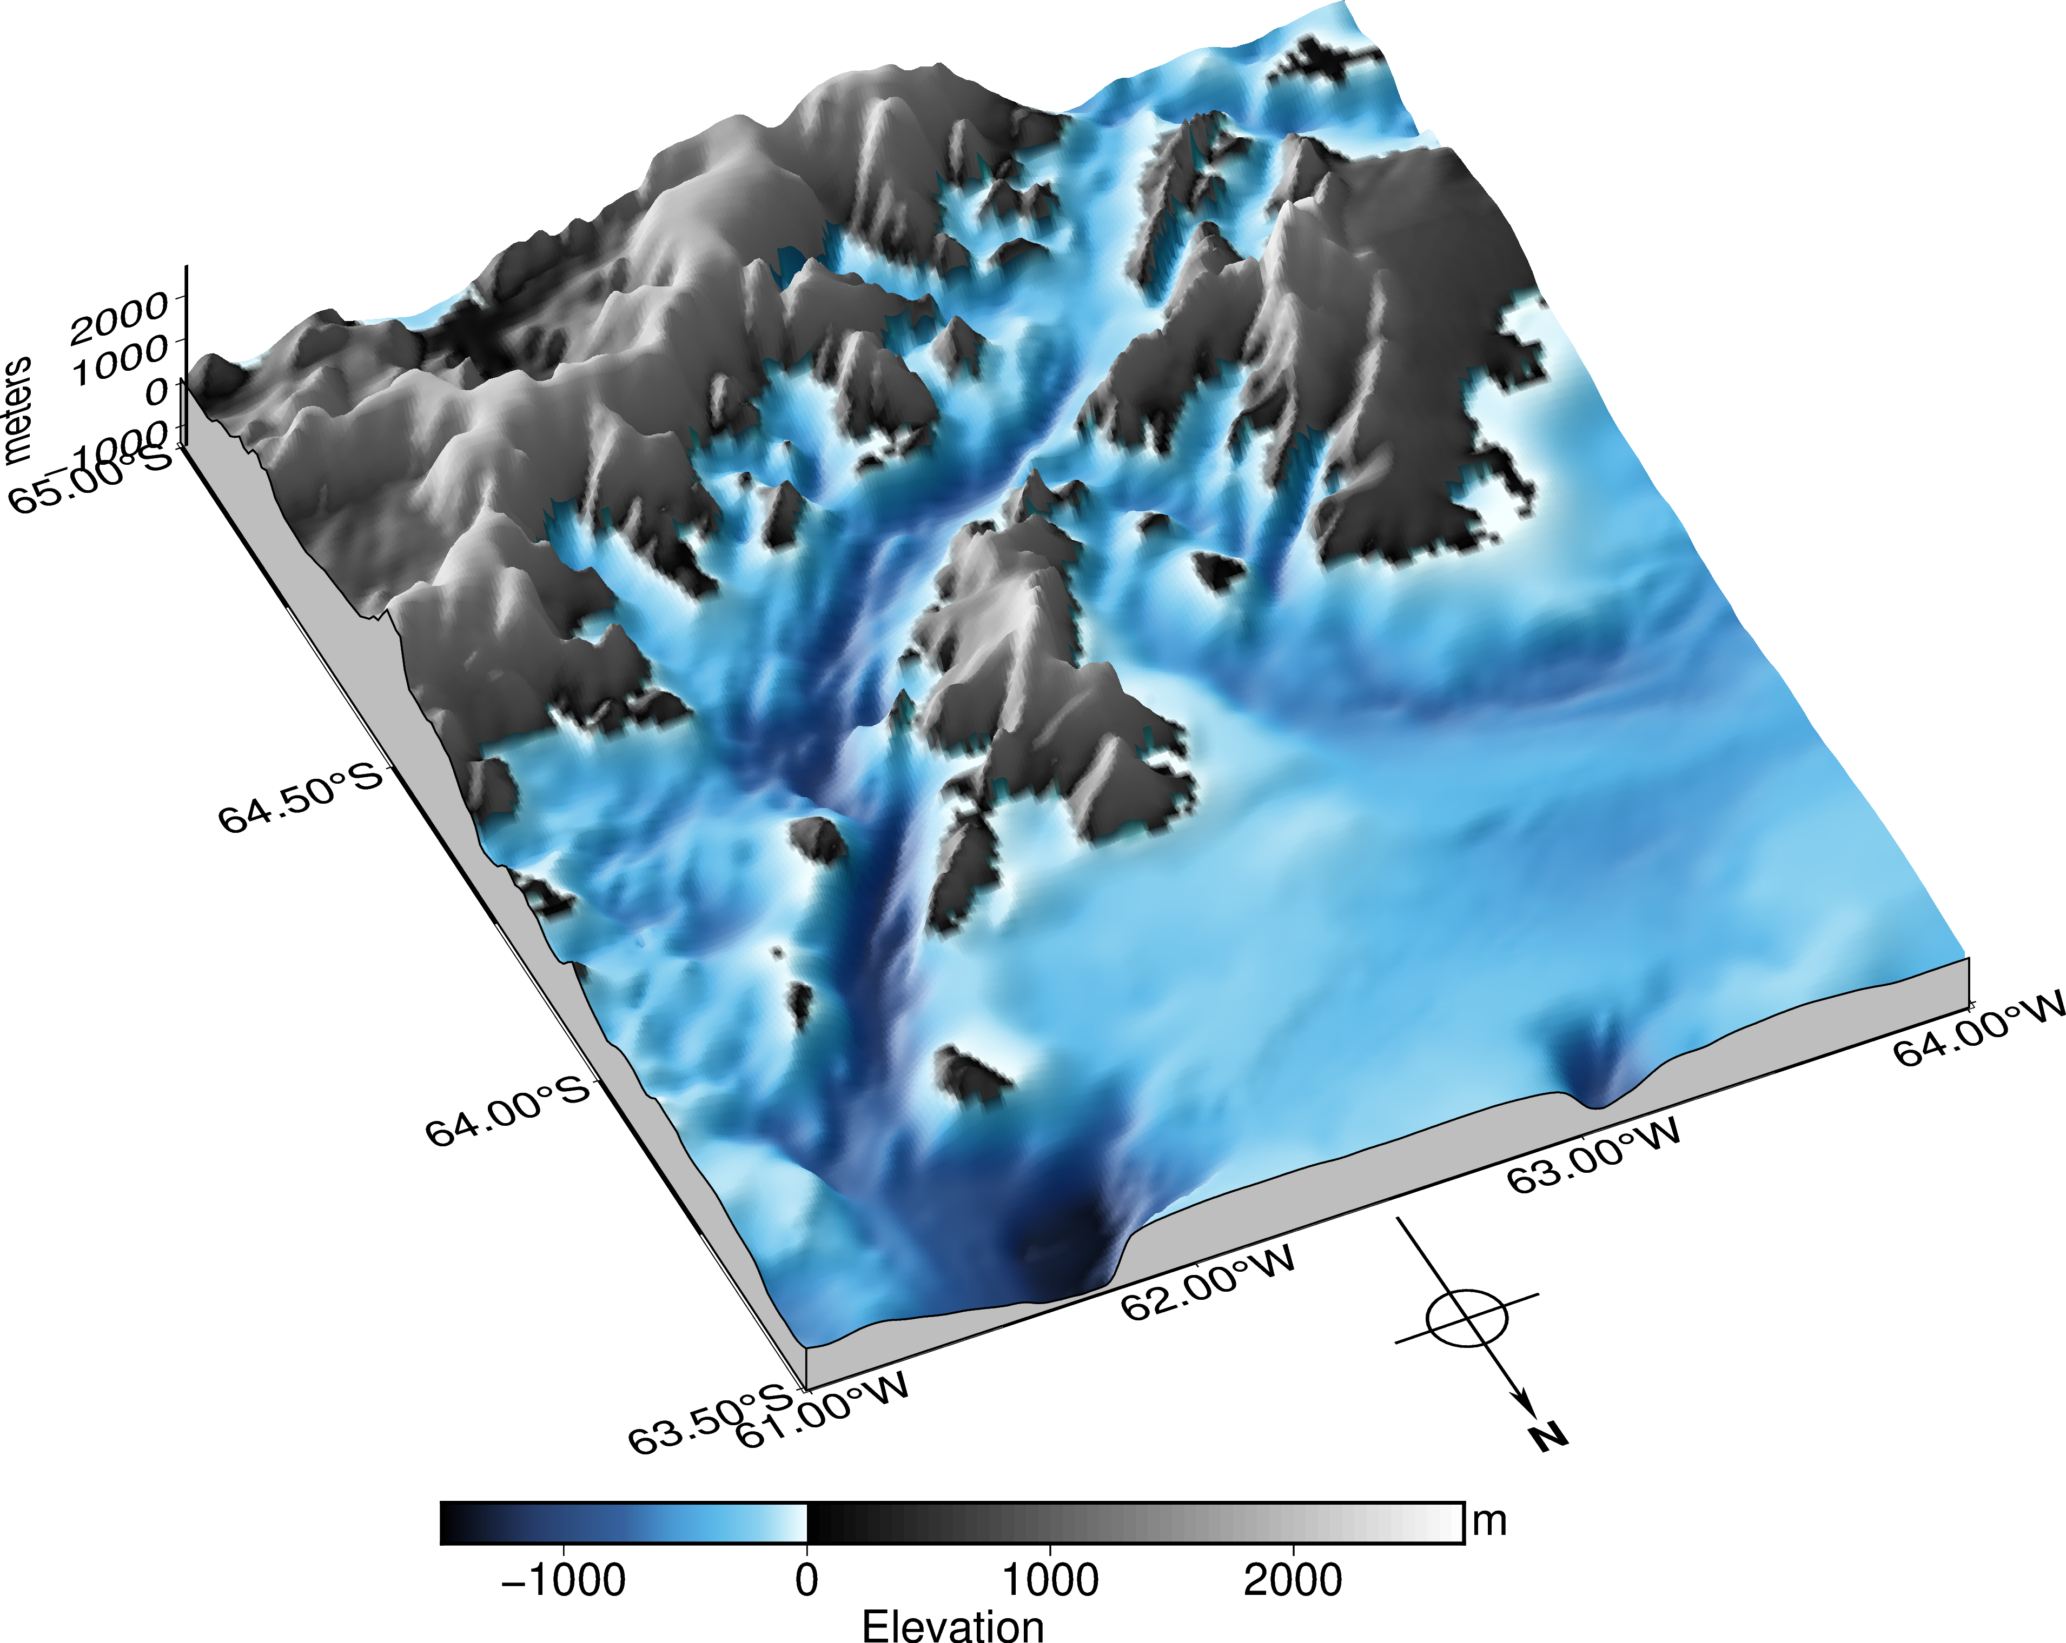
Gerlache strait
Paradise Bay
Neumeyer Channel
Andvord Bay
Wilhelmina Bay
Anvers Is.
Charlotte Bay
Brabant Is.
Two Hummock Is.

Slide 5
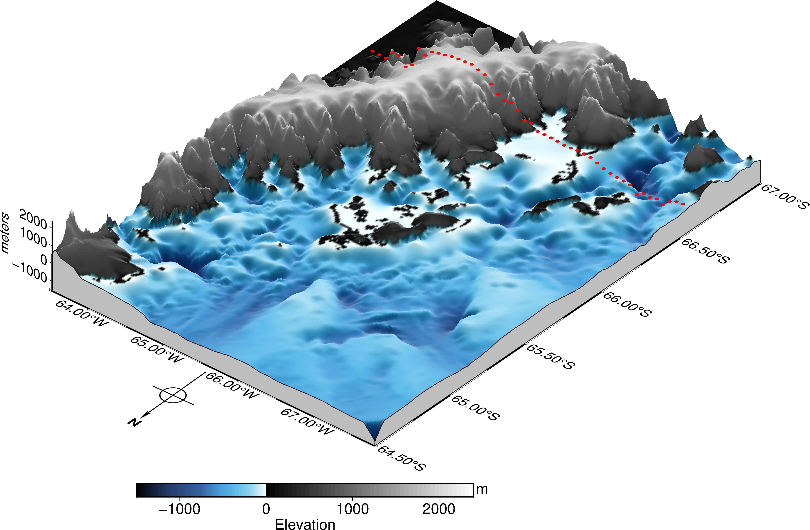
Polar Circle
Antarctic Peninsula
Lemaire Channel
Martha Strait
Lavoisier Is.
Renaud Is.
Anvers Is.

Slide 6
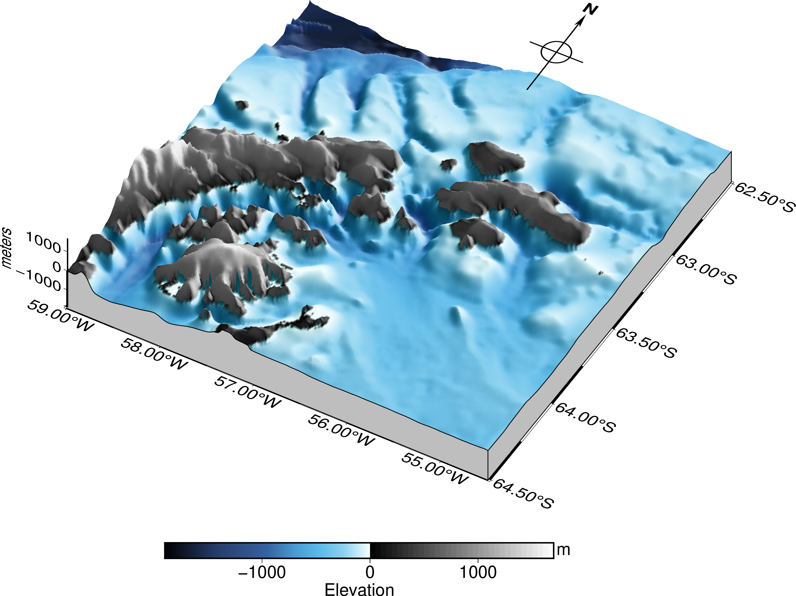
Antarctic Sound
Bransfield Strait
Joinville Is.
Weddell Sea
Danger Is.
James Ross Is.

